Slide 1
Updates on Modeling Bus-based Fabric
Anuparna
2nd Feb 2026

Slide 2
Agenda
Recap
Finite Buffer Set-up
Experiments with Finite Buffer & Equal Injection rates
Key Observation
Experiments with Finite Buffer & Different Injection rates

Slide 3
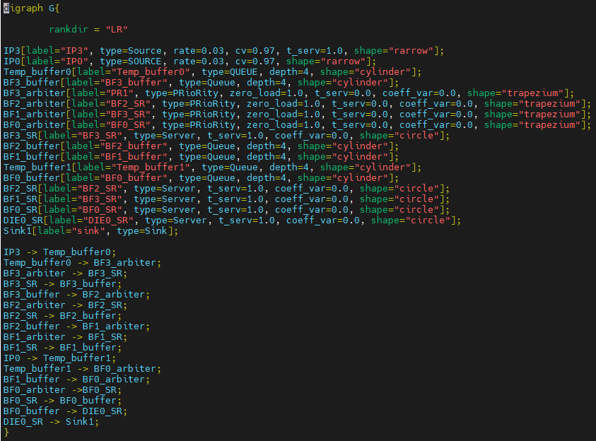
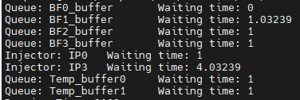
Recap:
Die0
Modeling bus-based fabric in DSL
Die1
Converted to .dot file
BF0
IP0 , IP3 are injectors[type: source]
And injected into temp_buffer first.
Each BF’s zero_load = 1 represents fixed one cycle delay.
IP3 traverses BF3 → BF2 → BF1 → BF0 → Die0 so IP3’s end-to-end latency = W(temp_buffer0) + W(BF3) + W(BF2) + W(BF1) + W(BF0)
IP0 traverses BF0 → Die0 so IP0’s end-to-end latency = W(temp_buffer1) + W(BF0)
BF(Bus Fabric) Setup
IP0
BF1
BF3
BF2
IP3
Input from Intel
Meaning of shapes in the diagram:
Arrow : Injector. [IP0, IP3]
Cylinder : buffer [temp_buffer, BF_buffer]
Trapezium : arbiter [BF_arbiter]
Circle : server
BF is the fabric instance and every BF has arbitration
IPs are the injectors and both IP0 and IP3 are sending packets to Die0. (assumption, IP0 packets have higher priority than IP3)
IP0 pkts and IP3 pkts arbitrate at PSF0.
Each BFs(BF0, BF1, BF2, BF3) causes 1 cycle delay (from input port to output) in addition to the arbitration. If no arbitration at a said BF, then assume delay = 1 cycle
Output verified on pen and paper

Slide 4
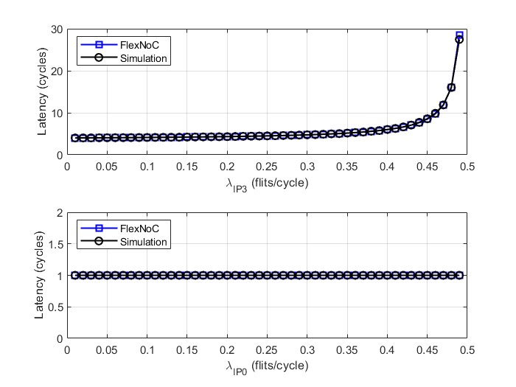
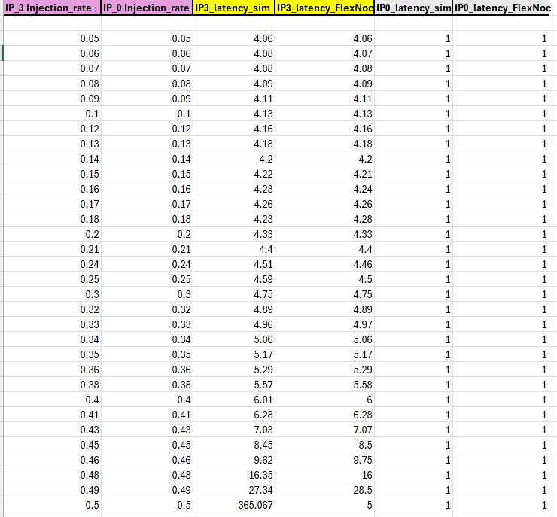
Recap: Cycle-accurate Simulation Vs FlexNoC for the given Configuration
Cycle accurate simulator construction:
Discrete-time model (Each loop = 1 clock cycle).
Packets injected at IP0/IP3 (injection rate-based), queued separately.
IP3 has fixed pipeline delay (BF3→BF2→BF1).
BF0–Die0 modeled as single server with fixed service time.
Latency is measured from injection to exit at Die0, and average latency is computed over all packets.
Latency comparison between cycle-accurate simulation and FlexNoC for IP0 and IP3
MAPE ≈ 0.20%
MAE ≈ 0.03
G
GitHub link

Slide 5
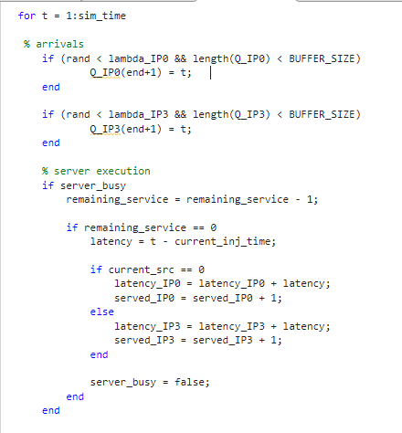
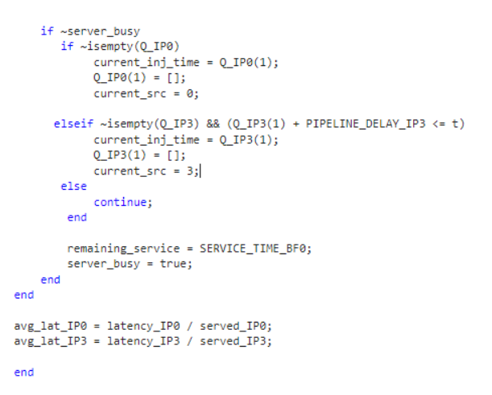
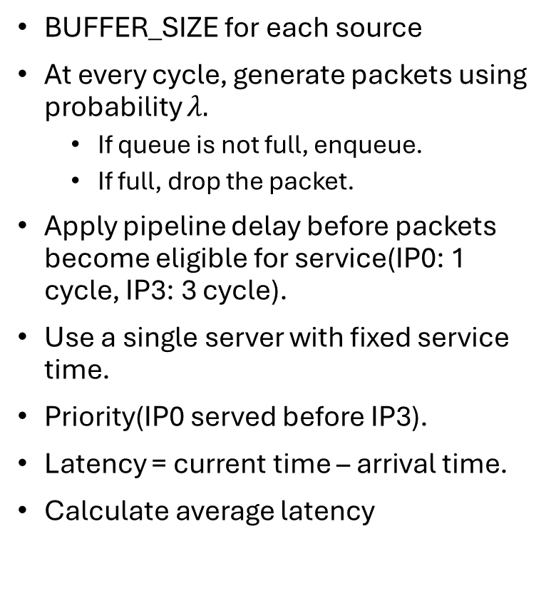
Finite Buffer Simulation
BUFFER_SIZE for each source
At every cycle, generate packets using probability $λ.$
If queue is not full, enqueue.
If full, drop the packet.
Apply pipeline delay before packets become eligible for service(IP0: 1 cycle, IP3: 3 cycle).
Use a single server with fixed service time.
Priority(IP0 served before IP3).
Latency = current time – arrival time.
Calculate average latency

Slide 6
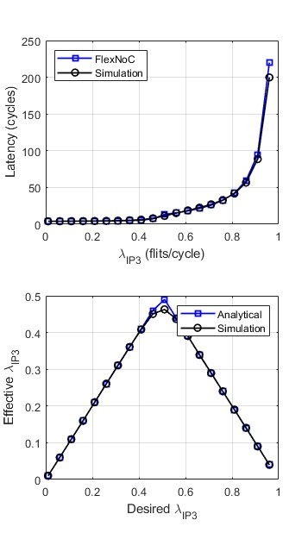
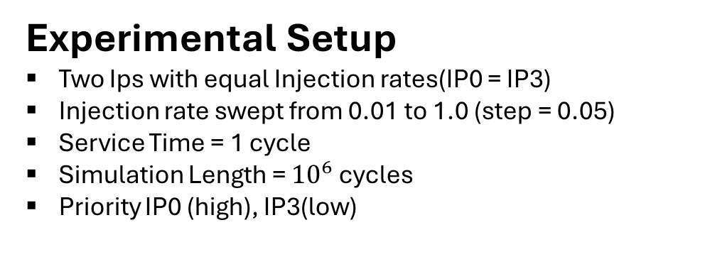
Performance Evaluation (Sim. Vs FlexNoC tool) for Buffer Size = 8
Experimental Setup
Two Ips with equal Injection rates(IP0 = IP3)
Injection rate swept from 0.01 to 1.0 (step = 0.05)
Service Time = 1 cycle
Simulation Length = ${10}^{6}$ cycles
Priority IP0 (high), IP3(low)
Key Results
IP3 Latency MAPE = 4.45%
Effective Injection MAPE (IP3) = 0.62 %

Slide 7
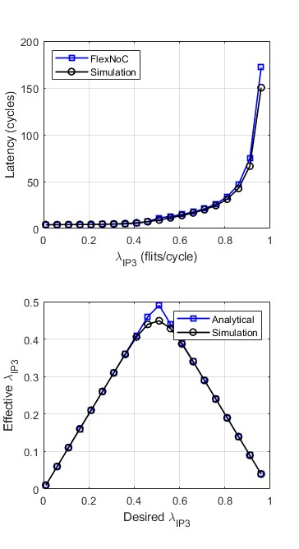
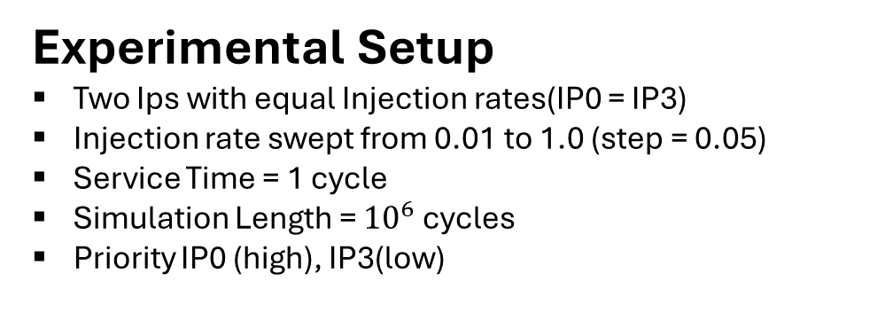
Performance Evaluation (Sim. Vs FlexNoC tool) for Buffer Size = 6
Experimental Setup
Two Ips with equal Injection rates(IP0 = IP3)
Injection rate swept from 0.01 to 1.0 (step = 0.05)
Service Time = 1 cycle
Simulation Length = ${10}^{6}$ cycles
Priority IP0 (high), IP3(low)
Key Results
IP3 Latency MAPE = 6.63 %
Effective Injection MAPE (IP3) = 1.08 %

Slide 8
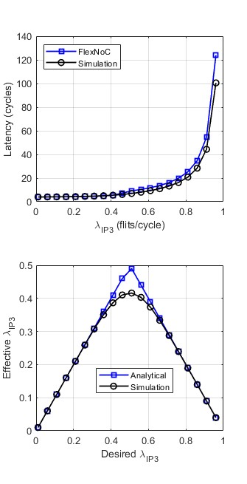
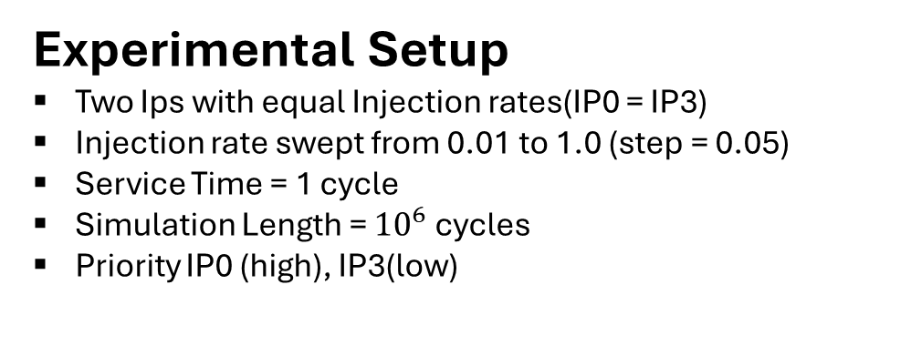
Performance Evaluation (Sim. Vs FlexNoC tool) for Buffer Size = 4
Experimental Setup
Two Ips with equal Injection rates(IP0 = IP3)
Injection rate swept from 0.01 to 1.0 (step = 0.05)
Service Time = 1 cycle
Simulation Length = ${10}^{6}$ cycles
Priority IP0 (high), IP3(low)
Key Results
IP3 Latency MAPE = 13.84 %
Effective Injection MAPE (IP3) = 2.99 %

Slide 9
Key Observations
Latency MAPE(IP3) decreases initially as buffer increases, reaches minimum around 7-8
Very small buffers cause drops; very large buffers increase waiting time(higher latency).
Effective injection MAPE is always very small(<3%), showing analytical model predicts throughput well.
Larger buffers mainly affect latency, not effective throughput

Slide 10
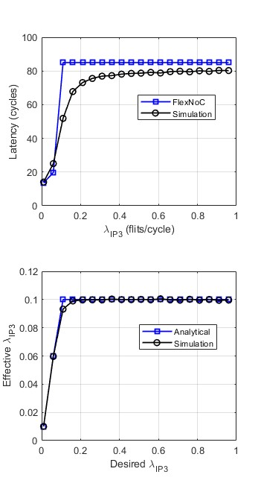
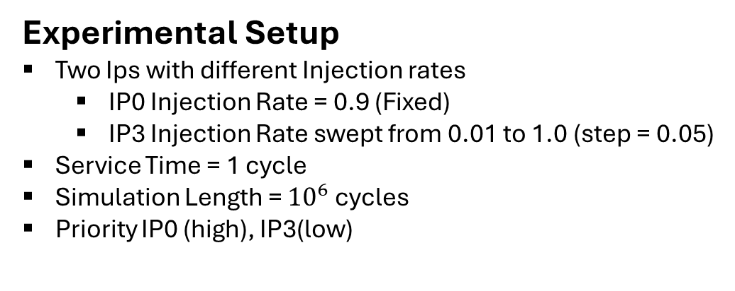
Performance Evaluation (Sim. Vs FlexNoC tool) for Buffer Size = 8
Experimental Setup
Two Ips with different Injection rates
IP0 Injection Rate = 0.9 (Fixed)
IP3 Injection Rate swept from 0.01 to 1.0 (step = 0.05)
Service Time = 1 cycle
Simulation Length = ${10}^{6}$ cycles
Priority IP0 (high), IP3(low)
Key Results
IP3 Latency MAPE = 12.42 %
Effective Injection MAPE (IP3) = 0.68 %
Observation
• Latency saturates as IP3 increases due to buffer limitation • Analytical model closely follows simulation for effective λIP3

Slide 11
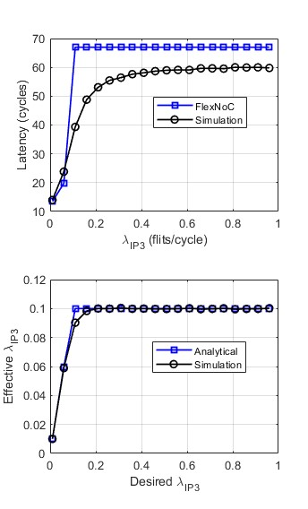
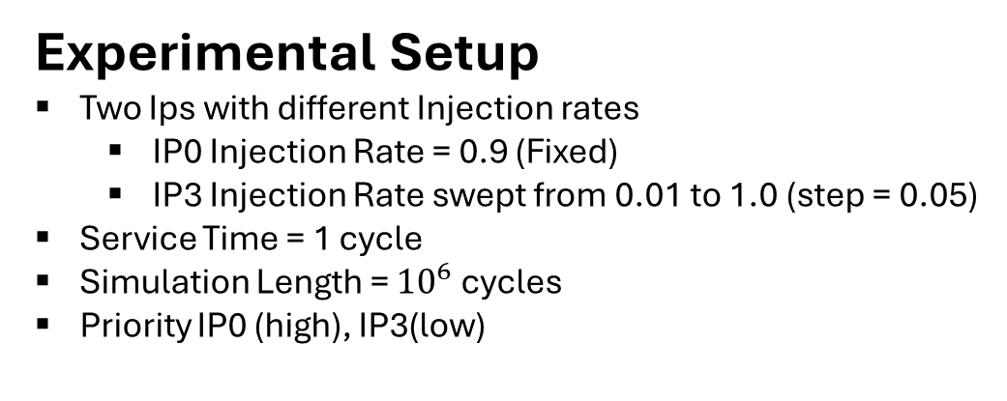
Performance Evaluation (Sim. Vs FlexNoC tool) for Buffer Size = 6
Experimental Setup
Two Ips with different Injection rates
IP0 Injection Rate = 0.9 (Fixed)
IP3 Injection Rate swept from 0.01 to 1.0 (step = 0.05)
Service Time = 1 cycle
Simulation Length = ${10}^{6}$ cycles
Priority IP0 (high), IP3(low)
Key Results
IP3 Latency MAPE = 18.20 %
Effective Injection MAPE (IP3) = 0.90 %
Observation
• Latency saturates at higher IP3 due to IP0 dominance, while effective λIP3 quickly reaches a steady limit. • Analytical model closely follows simulation for effective λIP3

Slide 12
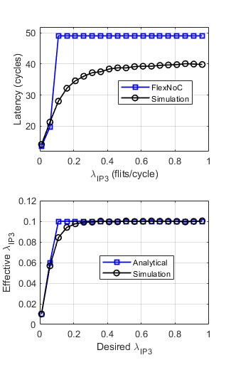
Performance Evaluation (Sim. Vs FlexNoC tool) for Buffer Size = 4
Experimental Setup
Two Ips with different Injection rates
IP0 Injection Rate = 0.9 (Fixed)
IP3 Injection Rate swept from 0.01 to 1.0 (step = 0.05)
Service Time = 1 cycle
Simulation Length = ${10}^{6}$ cycles
Priority IP0 (high), IP3(low)
Key Results
IP3 Latency MAPE = 28.72 %
Effective Injection MAPE (IP3) = 1.96 %
Observation
• Latency saturates earlier because of limited buffering, leading to stronger congestion effects.
• Analytical model closely follows simulation for effective λIP3

